Slide 1

SALARY ANALYSIS
SAKTHI ARAVIND K
DA&DS

Slide 2
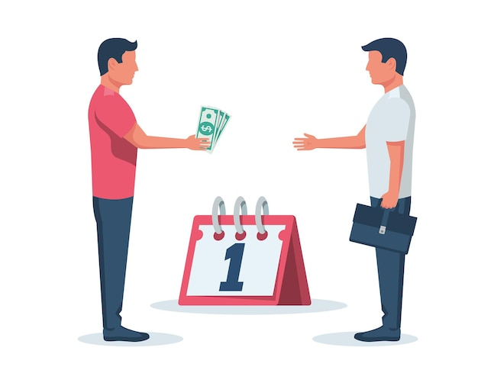
Objective of the Analysis
• Analyze salary trends across industries, experience levels, education, and gender.
• Identify salary discrepancies and trends across global regions.
• Provide insights into job titles, additional compensation, and key salary influencers.

Slide 3

Dataset Overview
Data from a global salary survey covering various industries and job roles.
Key attributes: Age Range, Industry, Job Title, Annual Salary, Compensation, Education, and Experience.
Includes salary data from multiple countries and currencies.

Slide 4

Handled missing values in Industry, Job Title, and City.
01
Standardized experience ranges and formatted salary data.
02
Ensured consistency in job titles, industry names, and location data.
03
Removed redundant or incomplete data for analysis accuracy.
Total Records After Cleaning:28103
Total Columns:15
Countries Represented: 142
Industries Covered:1191
Unique Job Titles:1270
04

Slide 5
Average Salary by Industry & Gender
Certain industries show significant salary gaps
Analyzed salary discrepancies between genders within industries.
03
02
Women in Academia have higher average salaries compared to men
Women is highest salary :
$8905474368
04
01

Slide 6
Total Compensation by Job Title
Some job titles offer significantly higher additional compensation
Investment Banking Analyst, Researcher, Senior It Consultant, Operations Manager, Software Enginee,etc..
Bonus structures vary significantly across industries
Data Science Student, College Senior, Homemaker , Househusband,etc

Slide 7
Salary Distribution by Education Level
College degree generally correlates with higher salaries
High school generally correlates with lower salaries
Master’s,Phd and Doctorate degrees lead to higher earning potential
Some industries value experience more than education

Slide 8

Industry-Wise Salary Trends
The following industries have the highest average salaries
Accounting, Banking & Finance
Computing or Tech
Education (Higher Education)
Engineering or Manufacturing
Health care
Utilities & Telecommunications
etc

Slide 9

Salary Distribution Analysis
Average Annual Salary:$81,003.90
Median Annual Salary: $74,000.00
Max Annual Salary: $193,200.00
Min Annual Salary: $0.00

Slide 10

Conclusion & Recommendations
Salary gaps exist based on industry, gender, education, and geography.
Compensation trends indicate high salaries in tech and finance sectors.
Future salary negotiations should factor in experience, location, and role-specific demands.
Companies should ensure fair pay structures and transparent compensation policies

Slide 11


